Slide 1

Intelligent Home Security System
Using STM32, ESP32, Ultrasonic Sensor, Servo Motor & Telegram
Presented By: Prasanth K

Slide 2


Project Overview
The Intelligent Home Security System is an IoT-based smart security solution designed to meticulously monitor and protect home entrances in real-time.
•
Real-time intrusion detection
•
Automatic door locking
•
Local alarm activation
•
Telegram mobile notifications
•
Cloud data storage (Firebase)
•
Remote monitoring via Wi-Fi

Slide 3






Key Objectives
Detect & Alert
Auto Lock
Cloud & Mobile
Swiftly detect any unauthorized entry and generate an immediate local alarm during the intrusion event to deter threats.
Automatically lock the main door upon sensing a potential intruder to prevent unauthorized physical access to the premises.
Instantly notify the owner via mobile alerts and seamlessly store all security event logs in the cloud for later review.

Slide 4
Hardware Components
Component | Purpose
STM32 NUCLEO-F446RE | Main Controller for Logic & Processing
ESP32 | Wi-Fi Communication & IoT Connectivity
HC-SR04 | Intrusion Detection (Distance Measurement)
SG90 Servo Motor | Automatic Door Lock Control Mechanism
Active Buzzer & LED | Local Security Alarm & Status Indicator
Firebase & Telegram | Cloud Data Storage & Instant Mobile Alerts

Slide 5



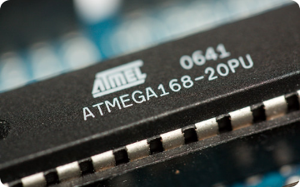


System Architecture
1. Input & Sensing: Ultrasonic sensor precisely monitors the entrance area.
2. Core Processing: STM32 controller processes logic and triggers local actuators.
3. Communication: ESP32 bridges Wi-Fi to Firebase and user's Telegram Bot.

Slide 6
Operational Workflow
2. Monitor
4. Alert
Secure the lock and continuously monitor distance for any sudden anomalies.
Transmit data to send Telegram alert and update Firebase logs.
1. Startup
3. Action
Power ON system, initialize STM32, and connect ESP32 to Wi-Fi network.
Upon intrusion detection, instantly lock door and trigger local alarm.

Slide 7


Step 1: System Initialization
Local Subsystem Setup
Network & Monitoring
Upon Power ON, the STM32 initializes its core peripherals. The servo motor defaults to securing the door lock, and the local alarm (Buzzer/LED) strictly remains OFF.
Simultaneously, the ESP32 establishes a secure connection to the designated Wi-Fi network. Once authenticated, the system seamlessly enters continuous monitoring mode.

Slide 8
Step 2: Intrusion Detection
< 40
Ultrasonic Monitoring
The highly precise HC-SR04 continuously measures the distance at the entrance.
If the distance unexpectedly drops below 40 cm, an intrusion is immediately detected by the system.
Centimeters (cm)
Example: A steady distance of 150 cm is considered completely Safe.

Slide 9
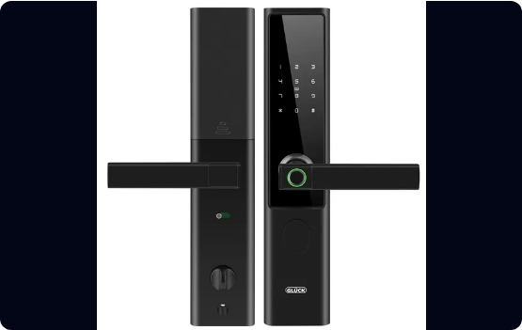
Step 3: Door Control
Automatic Door Lock
When an intrusion is successfully detected, the main controller takes immediate protective action.
The STM32 drives the SG90 Servo Motor, commanding it to rotate and mechanically lock the door, effectively preventing any physical unauthorized entry.
Intruder → Servo Motor → Door Locked

Slide 10

Step 4: Alarm Generation
Local Security Alarm
Simultaneous with locking the door, the STM32 immediately activates the onboard Active Buzzer and an intense flashing LED indicator.
This high-decibel audible alert combined with visual flashing ensures that nearby people and residents are instantly alerted to the unauthorized presence.

Slide 11


Step 5: Communication
STM32 → ESP32 UART Protocol
Upon sensing the threat, the STM32 microcontroller immediately transmits a critical "INTRUDER" string sequence through its UART hardware interface.
The ESP32 asynchronously receives this message over Serial and instantly prepares the networking payload to dispatch the cloud and mobile notifications.

Slide 12


Step 6: Telegram Notification
Instant Mobile Alert
Leveraging its Wi-Fi connection, the ESP32 securely pushes real-time data using the Telegram Bot API directly to the homeowner's smartphone.
🚨 SECURITY ALERT
Intruder Detected
• Location: Main Door
• Door: Locked
• Alarm: Activated

Slide 13


Step 7: Firebase Cloud
Cloud Monitoring Integration
Data Log Example
Time: 10:35 PM
The ESP32 module reliably uploads critical event parameters directly to a Firebase Realtime Database. This ensures permanent historical logging and enables immediate remote access.
Date: Current System Date
Distance: 22 cm
Door Status: Locked
Alarm Status: ON

Slide 14






Complete Data Flow
1. Sensing Phase
2. Actuation Phase
3. Cloud Phase
An unknown person approaches the door → The Ultrasonic Sensor detects the proximity change → Raw data is sent to the STM32.
UART signal to ESP32 → Transmits via Wi-Fi → Hits Telegram Bot API (Alert) & updates Firebase Database.
STM32 processes logic → Immediately activates Servo Motor to lock the door & triggers the Buzzer alarm.

Slide 15
System Advantages
Cost-Effective: Delivers a low-cost yet highly robust smart security solution using accessible microcontrollers.
Proactive Defense: Automatic door locking prevents physical entry before an intruder can compromise the lock.
Immediate Awareness: Instant mobile notifications via Telegram ensure you know about a threat seconds after it happens.
Data Accountability: Cloud-based event logging keeps a permanent, untamperable record of all security anomalies.
Energy Efficient: Optimized embedded design ensures low power consumption during continuous monitoring.

Slide 16



Target Applications
Smart Homes & Premium Apartments
Corporate Offices & R&D Laboratories
Banks, Vaults & Restricted Access Areas

Slide 17
Future Scope & Enhancements
Biometric Integration: Add Face Recognition and Fingerprint authentication for secure owner access.
Keyless Entry: Incorporate RFID door access to easily manage and log authorized entries.
Visual Verification: Integrate an ESP32-CAM module for live camera streaming directly to the mobile app.
Advanced Algorithms: Employ AI-based intrusion detection to differentiate between pets and human intruders.
Smart Integrations: Dedicated mobile app dashboard and Voice Assistant (Alexa/Google) integration.

Slide 18


Expected System Output
Normal Condition
Intrusion Detected
Door Locked / Secure
Door Locked Automatically
Alarm is OFF
Alarm is Activated
Monitoring is Active
Telegram Notification Sent
Firebase Database Updated

Slide 19
Conclusion
The Intelligent Home Security System elegantly combines embedded technologies and IoT to provide a highly reliable, low-cost solution that enhances safety and enables real-time remote monitoring.
"
— Project Summary
"

Slide 20
Thank You!
Questions & Discussion
Intelligent Home Security System

